Slide 1
K-5 Lansing Elementary/Intermediate Schools
Overview for Lansing Board Members

Slide 2
Why/How did we get here?
In December after 24 years of teaching I experienced mid career crisis, teacher burn out, self evaluation call it what you may.
Had some conversations with Mr. Wessel and then Mr. Azzeh and Dr. Kolb looking for something that fit me
They challenged me to research and develop a STEM Program for LES/LIS
Found many options: KidSpark, Learning Labs, Snapology, Lego Builds, Mrs. Phillips’ ideas and Project Lead The Way.
Applied for a grant through Project Lead The Way
Received $10,000 grant which covers
Professional Development over the program and content
Participation fee: includes software access to program for students and teachers, and teacher support

Slide 3
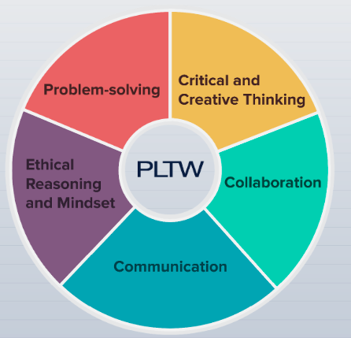
Why STEM?
WE DO NOT HAVE IT! Other districts such as Fort Leavenworth, Basehor, DeSoto, Piper, Olathe, Blue Valley, Shawnee Mission and Catholic Schools around the area have had it for years. Many have STEM in all grade levels.
STEM programs provide our students with an opportunity to embrace real world concepts and problems in a hands-on learning environment.
Our littlest learners will be practicing 21sr century learning skills that employers have said are the most important skills they look for.
*PLTW :Project Lead The Way
Notes:
We have Science classes but that is just getting the information but STEM is the real world application of the scientific knowledge hey have gained

Slide 4
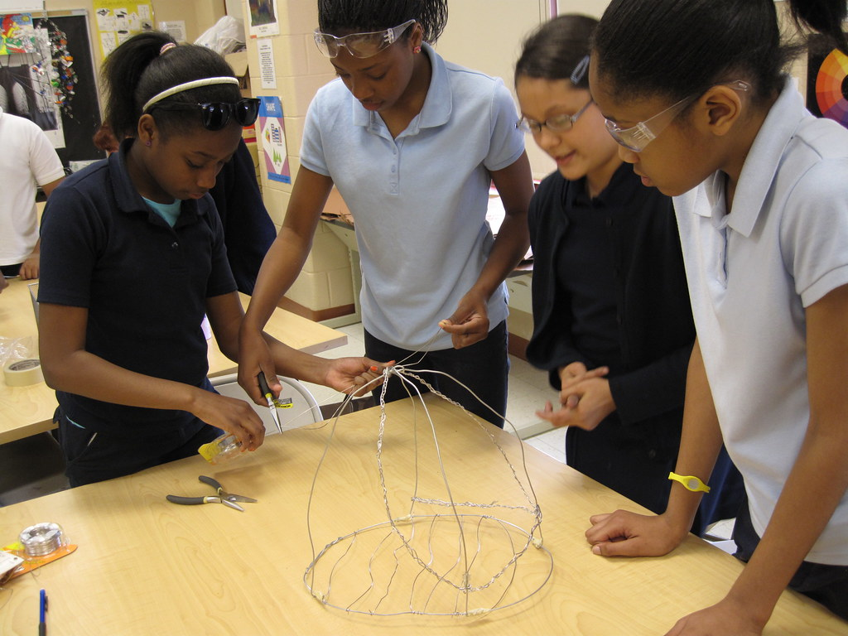
Starting with Launch K-5 :Taps into exploratory nature engages them in learning that feels like play and encourages them to keep discovering through activities, projects and problem solving
Starting with 3 to 4 different learning modules at each grade level.
Spent the summer making sure that the Science Guaranteed Viable Curriculum (GVC) and the modules align. In fact, all standards including Engineering standards are meet. Aligned modules from PLTW to the current reading series essential questions to introduce around the same time to allow for connection. Why? Because learning doesn’t happen separately. Math doesn’t only happen in math class, reading doesn’t only happen in reading class.
https://instructional-resources.s3.amazonaws.com/PLTW_Launch/10042_StabilityandMotionForcesandInteractions/English_External_Files/3_2_Standards.pdf
Notes:
Meghan will draw their attention to packets the launch module description is packet.

Slide 5
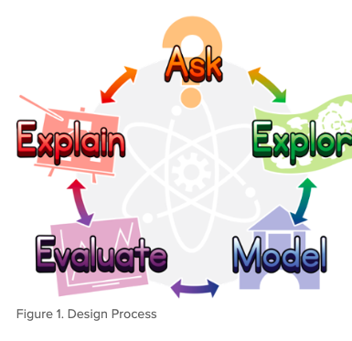
1st Growth Mind set. We can learn to do hard things, Persevere
2nd Members of a team and the roles each members plays.
3rd Engineering Design Model. How to develop ideas, plan it, build, evaluate and revisit.
4th PLTW Modules
3-4 modules per grade level
Implementation of PLTW
PreK
K
1st
2nd
3rd
4th
5th

Slide 6
Kindergarten Modules
Pushes & Pulls
Living Things Needs and Impacts
Sunlight & Weather

Slide 7
1^{st Grade} Modules
Light & Sound
Animal Adaptations
Light Observing Sun, Moon, and Stars

Slide 8
2^{nd grade} Modules
The Changing Earth
Materials Science: Properties of Matter
Materials Science: Form and Function

Slide 9
3^{rd Grade} Modules
Variation of Traits
Weather: Factors and Hazards
Stability and Motion: Forces and Interactions

Slide 10
4^{th Grade} Modules
Energy Conversions
Waves and the Properties of Light
Organisms Structure and Function
Earth: Past, Present, and Future

Slide 11
5^{th Grade} Modules
Earth’s Water and Interconnected Systems
Patterns in The Universe
Ecosystems: Flow of Matter and Energy
Matter: Properties and Reactions

Slide 12
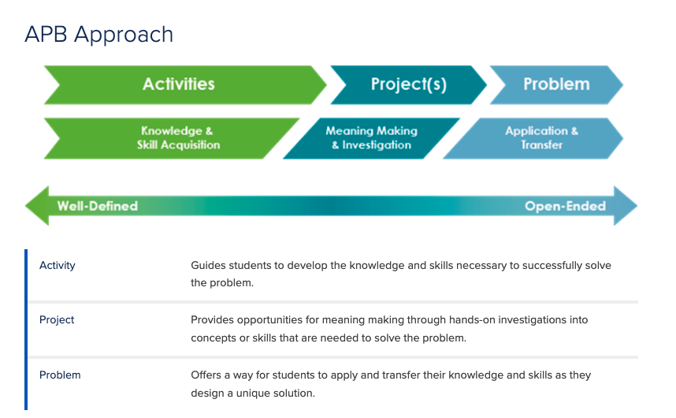
Module Flow
APB Approach
APB Approach
APB Approach
Introduction Story
Activy 1
Notes:
Meghan explain module set up

Slide 13
Plan for Community involvement and growing program
STEM Information Night
STEM Family Nights (Come Build With Me!)
End of each quarter come see what we have been doing
Bringing in experts from our community
General Contractors
STEM Offered in Middle School and High School
PLTW Gateway
PLTW Computer Science
PLTW Engineering 9-12
PLTW Biomedical Science
Before, During After open House
Information distributed
Web page
9-12
9-12
6-8
Doctors
Veterinarians
Engineers
Chemist
Parent volunteers on build days
Summer Camp

Slide 14
Funding
Applied for Grant through PLTW
Received $10,000 for 3 years covering Professional Development and $950 a year for access to the curriculum, master teachers, and technology.
Grant hunting
LEF Grants
PTA
Fund raising: BBQ Contest held at school
Entry fee $$$, board be judges?, student judges
Lots of backyard bbq masters out there, best. Kids hamburger, dessert etc.
Have tasting pay little extra to try at stands that are willing

Slide 15
Mr. Wessel, Mr. Azzeh, Dr. Kolb, Mr. Altieri, and Board Members!
For investing in our children by seeing and understanding the need for this type of education
Approving this position
Mostly for giving us this opportunity to make the biggest impact possible

